Slide 1
Submitted To:
Md. Khaliluzzaman
Assistant Professor
Dept. of CSE, IIUC
Face & Eyes Detection using Haar Cascades
Submitted By:
C151084
Shahriar Md.Mahir Hasnat
C151085
Md Abid Uddin
C151091
Md Mezba Uddin Kawser

Slide 2
Objective
1. Face detection using Haar Feature-based Cascade Classifiers
2. Same for eye detection.

Slide 3
What is Face detection?
Face detection is the ability of computer technology to identify people’s faces within digital images. Face detection applications employ algorithms focused on detecting human faces within larger images that may contain landscapes, objects etc.

Slide 4
How Face detection works?
While the process is somewhat complex, face detection algorithms often begin by searching for human eyes. Eyes constitute what is known as a valley region and are one of the easiest features to detect. Once eyes are detected, the algorithm might then attempt to detect facial regions including eyebrows, the mouth, nose, nostrils, and the iris.

Slide 5
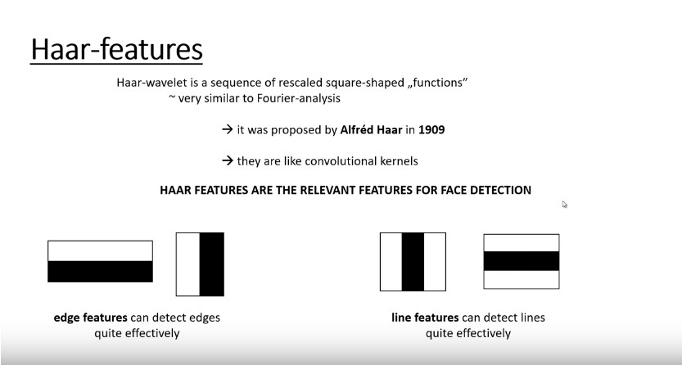

Slide 6


Slide 7
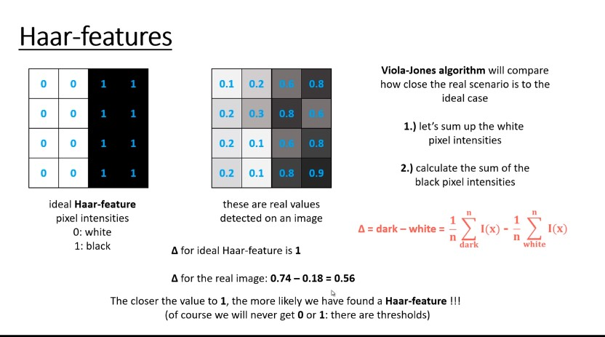

Slide 8
Thank You

